Slide 1


florida state university schools
girls’ soccer program
2018-2019

Slide 2
florida state university schools
girls’ soccer program
Mission Statement
In collaboration with the College of Education at Florida State University, the mission of Florida State University Schools is to advance Florida's K-12 education through exemplary teaching, research, and service.

Slide 3
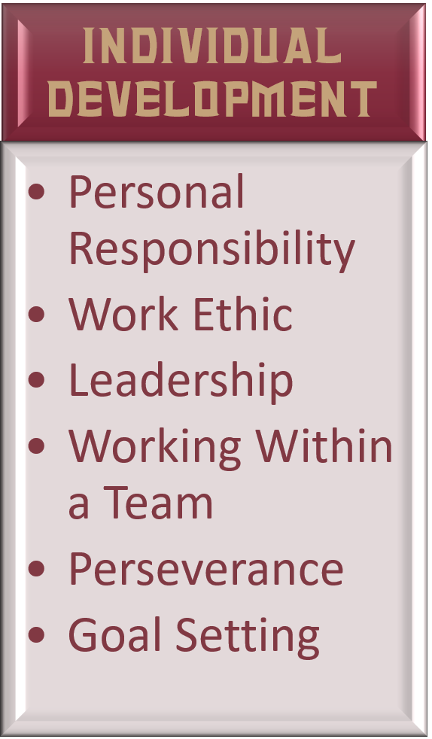
florida state university schools
girls’ soccer program
Program Goals
Instill each player with a strong work ethic and desire to succeed.
Teach each player to work within a team, focus on the greater good and to take responsibility for themselves and their actions.
Teach each team to play as a unit with an understanding that every player on the team has a purpose and a role at all times during the game.

Slide 4
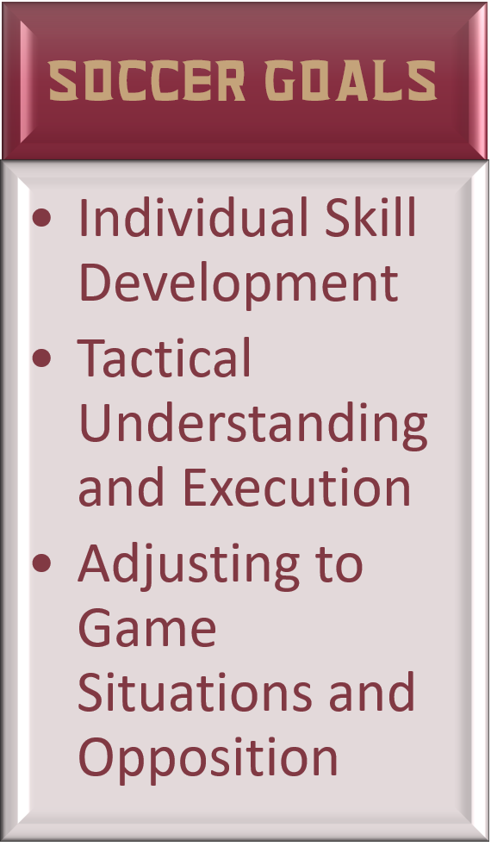
florida state university schools
girls’ soccer program
Program Goals
Foster a program designed for long term competitive excellence.
Develop a tactical system that accentuates the strengths of the team and a tactical understanding within each team that allows them to adapt to varying challenges.
Promote technical development in each player.

Slide 5
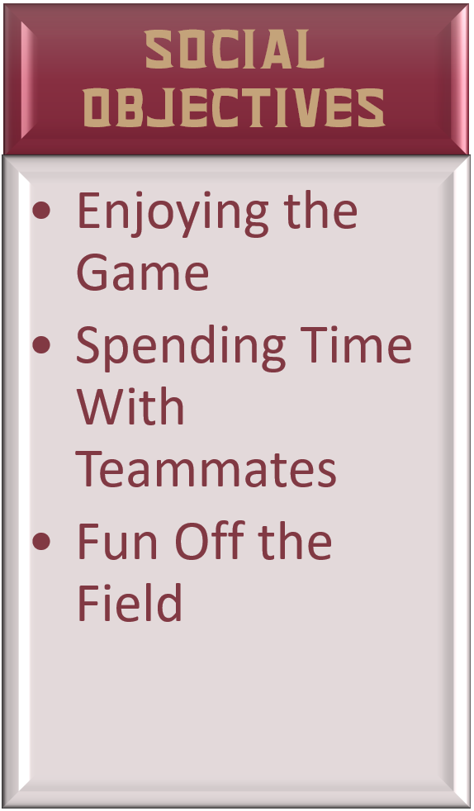
florida state university schools
girls’ soccer program
Program Goals
The primary goals of the program are educational and athletic. We want the girls to develop as young women and as soccer players.
We want to prepare them for success on the field, as well as success in whatever they chose to do when the leave FSUS.
We also want them to enjoy their time in the program. Enjoy their teammates. Enjoy the experience. Enjoy the game.

Slide 6
florida state university schools
girls’ soccer program
Tryouts Schedule
DAY 1 Monday October 22, 2018
4:00-4:30pm FSUS Soccer Field Check-In
4:30-6:00pm FSUS Soccer Field Small Sided Games (All Players)
DAY 2 Tuesday October 23, 2018
4:00p – 6:00p FSUS Soccer Field 8v8
DAY 3 Wednesday October 24, 2018
4:00p – 6:00p FSUS Soccer Field Middle School
6:00p – 8:00p FSUS Stadium High School
DAY 4 Thursday October 25, 2018
4:00p – 6:00p FSUS Soccer Field Middle School
6:00p – 8:30p FSUS Soccer Field High School
Teams will be announced Friday Morning. Practices will begin Friday after school.

Slide 7
florida state university schools
girls’ soccer program
Tryouts Teams
VARSITY Top 20 Players
JUNIOR VARSITY Next 20 Players
MIDDLE SCHOOL Top 20 Remaining Middle School Players
Roster Sizes 20 is a lot of players. We want to give every player the opportunity to benefit from interscholastic sports.
Notes:
Varsity Consider positions. If our best 20 are all attackers…
There is a physical component to player effectiveness. Middle School players can make varsity, but be aware of the physical demands playing against 17-18 year olds when setting expectations.

Slide 8
florida state university schools
girls’ soccer program
Tryouts Tips
Stress and nervousness are normal, but are they helpful?
What is it you want? What do you need to do to achieve it?
Work hard Be willing to make mistakes
Be confident Try to relax
Work off the ball Be a good teammate
Everyone defends, Everyone attacks

Slide 9
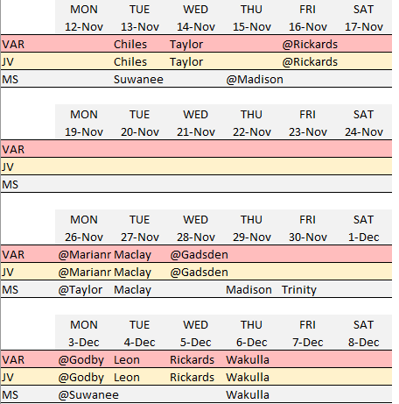
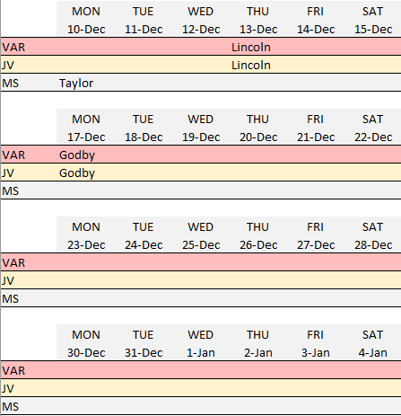
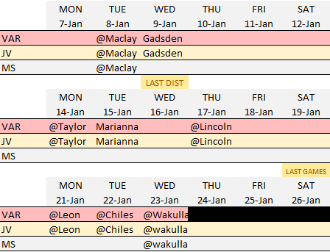
florida state university schools
girls’ soccer program
Game Schedules

Slide 10
florida state university schools
girls’ soccer program
BUSING
Varsity Away games outside of Tallahassee
Junior Varsity All away games
Middle School All away games
If at all possible players should be on the bus.

Slide 11
florida state university schools
girls’ soccer program
Playing Time
At all levels,playing time is earned
Varsity
Players on the field will be dictated by the demands of the game
Junior Varsity and middle school
Playing time will not be equal, but all players should play a significant portion of each game
.

Slide 12
florida state university schools
girls’ soccer program
Playing Time
What is needed to ensure playing time
Work hard in practice
Attendance
Academically eligible
Behavior and attitude
Pay attention during the game
Be ready to play
.

Slide 13
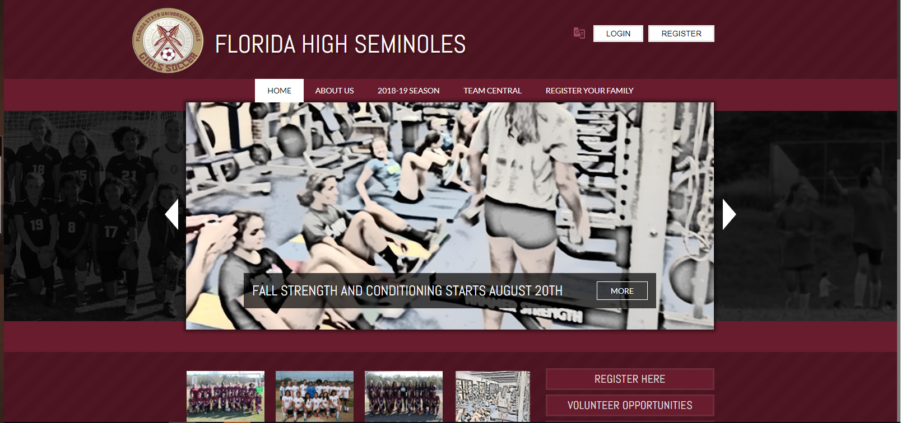
florida state university schools
girls’ soccer program
Program Website

Slide 14
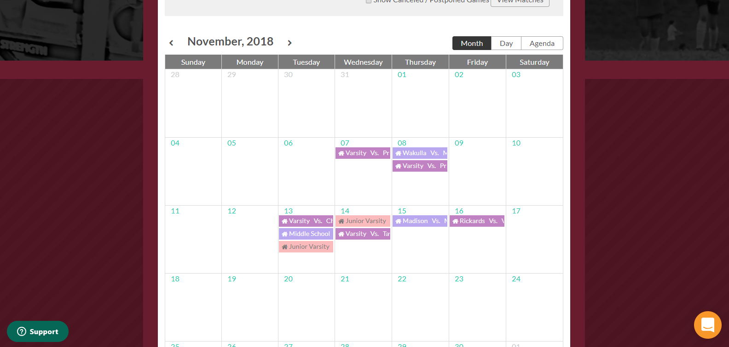
florida state university schools
girls’ soccer program
Program Website

Slide 15
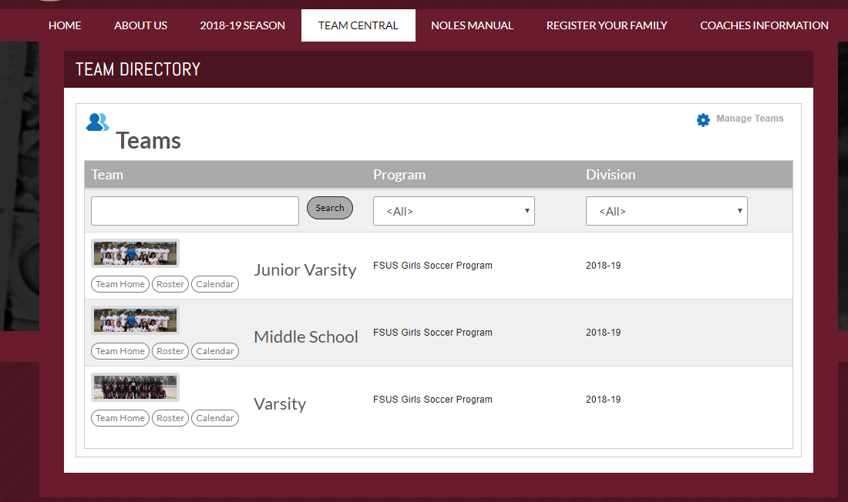
florida state university schools
girls’ soccer program
Program Website

Slide 16


Game Day Operations
Ticketing Administration
Ticket Takers
Concession Operations
Concessions Staff
Field Setup
Stadium Announcer
Game Recording
Ball Kids
Event Planning
End of Year Banquet
Senior Recognition / Senior Night
Team Dinners
Other Game Day Events (Community Night, Teacher Appreciation, etc.)
Other:
Marketing and Finance
Sponsorships
Finances and Accounting
Other:
Program Administration
Uniforms
Team Apparel
Fan Apparel
florida state university schools
girls’ soccer program
Volunteers
Game day operations
Event Planning
Marketing and Finance
Program Administration

Slide 17
Game Day Operations
Ticketing Administration
Ticket Takers
Concession Operations
Concessions Staff
Field Setup
Stadium Announcer
Game Recording
Ball Kids
Event Planning
End of Year Banquet
Senior Recognition / Senior Night
Team Dinners
Other Game Day Events (Community Night, Teacher Appreciation, etc.)
Other:
Marketing and Finance
Sponsorships
Finances and Accounting
Other:
Program Administration
Uniforms
Team Apparel
Fan Apparel
florida state university schools
girls’ soccer program
Game Day Operations
Ticketing Administration
Ticket Takers
Concessions Operations
Concessions Staff
Field Setup
Stadium Announcer
Game Recording
Ball Kids

Slide 18
Game Day Operations
Ticketing Administration
Ticket Takers
Concession Operations
Concessions Staff
Field Setup
Stadium Announcer
Game Recording
Ball Kids
Event Planning
End of Year Banquet
Senior Recognition / Senior Night
Team Dinners
Other Game Day Events (Community Night, Teacher Appreciation, etc.)
Other:
Marketing and Finance
Sponsorships
Finances and Accounting
Other:
Program Administration
Uniforms
Team Apparel
Fan Apparel
florida state university schools
girls’ soccer program
Event Planning
End of Year Banquet
Senior Recognition
Senior Night
Team Dinners
Other game day events
  Community Night
  Teacher Appreciation
  etc

Slide 19
Game Day Operations
Ticketing Administration
Ticket Takers
Concession Operations
Concessions Staff
Field Setup
Stadium Announcer
Game Recording
Ball Kids
Event Planning
End of Year Banquet
Senior Recognition / Senior Night
Team Dinners
Other Game Day Events (Community Night, Teacher Appreciation, etc.)
Other:
Marketing and Finance
Sponsorships
Finances and Accounting
Other:
Program Administration
Uniforms
Team Apparel
Fan Apparel
florida state university schools
girls’ soccer program
Marketing and Finance
Sponsorships
Finances and Accounting

Slide 20
Game Day Operations
Ticketing Administration
Ticket Takers
Concession Operations
Concessions Staff
Field Setup
Stadium Announcer
Game Recording
Ball Kids
Event Planning
End of Year Banquet
Senior Recognition / Senior Night
Team Dinners
Other Game Day Events (Community Night, Teacher Appreciation, etc.)
Other:
Marketing and Finance
Sponsorships
Finances and Accounting
Other:
Program Administration
Uniforms
Team Apparel
Fan Apparel
florida state university schools
girls’ soccer program
Program Administration
Team Apparel
Fan Apparel
Tryout Assistance
  Monday October 22nd
  330-430pm
  3-4 Volunteers
  Check-in players and handout tryout jerseys
  Player headshots

Slide 21
Game Day Operations
Ticketing Administration
Ticket Takers
Concession Operations
Concessions Staff
Field Setup
Stadium Announcer
Game Recording
Ball Kids
Event Planning
End of Year Banquet
Senior Recognition / Senior Night
Team Dinners
Other Game Day Events (Community Night, Teacher Appreciation, etc.)
Other:
Marketing and Finance
Sponsorships
Finances and Accounting
Other:
Program Administration
Uniforms
Team Apparel
Fan Apparel
florida state university schools
girls’ soccer program
Volunteers
Volunteers are essential for a successful season and a successful program.
An interest-sign up sheet will be going out to all families.
If volunteers are not available for all needs, “Volunteers” will be assigned.

Slide 22
Game Day Operations
Ticketing Administration
Ticket Takers
Concession Operations
Concessions Staff
Field Setup
Stadium Announcer
Game Recording
Ball Kids
Event Planning
End of Year Banquet
Senior Recognition / Senior Night
Team Dinners
Other Game Day Events (Community Night, Teacher Appreciation, etc.)
Other:
Marketing and Finance
Sponsorships
Finances and Accounting
Other:
Program Administration
Uniforms
Team Apparel
Fan Apparel
florida state university schools
girls’ soccer program
Player Expectations
THE TEAM COMES FIRST
To be successful we must make the best use of each player's strengths and unique abilities and collectively cover for each player's weaknesses. In possession we must work as a unit to create scoring opportunities. Without the ball we must defend as a team with every player doing their part.
We will only be successful as a team. We will be a team on game days, at practices and off the field.

Slide 23
Game Day Operations
Ticketing Administration
Ticket Takers
Concession Operations
Concessions Staff
Field Setup
Stadium Announcer
Game Recording
Ball Kids
Event Planning
End of Year Banquet
Senior Recognition / Senior Night
Team Dinners
Other Game Day Events (Community Night, Teacher Appreciation, etc.)
Other:
Marketing and Finance
Sponsorships
Finances and Accounting
Other:
Program Administration
Uniforms
Team Apparel
Fan Apparel
florida state university schools
girls’ soccer program
Player Expectations
FOCUS ON WHAT YOU CAN CONTROL
On game day we have two basic goals. Put the ball into the other net and keep the ball out of ours. Unfortunately achieving those two goals is not an easy feat. It will take every bit of focus, effort, energy and commitment we have to offer.
Players frequently complain about field conditions, referees, the weather, annoying fans, opponents with attitude and more. These are all aspects of the game that are out of our control.
Focus on what you can control and focus on the task at hand

Slide 24
Game Day Operations
Ticketing Administration
Ticket Takers
Concession Operations
Concessions Staff
Field Setup
Stadium Announcer
Game Recording
Ball Kids
Event Planning
End of Year Banquet
Senior Recognition / Senior Night
Team Dinners
Other Game Day Events (Community Night, Teacher Appreciation, etc.)
Other:
Marketing and Finance
Sponsorships
Finances and Accounting
Other:
Program Administration
Uniforms
Team Apparel
Fan Apparel
florida state university schools
girls’ soccer program
Player Expectations
RESPECT EVERYONE
Sportsmanship and respect should always be a part of competition. All too often these days sportsmanship is gone. Parents, players and coaches are yelling at the referee. Fans and teammates are taunting the opposition. Players spend as much time complaining about or arguing with their teammates as they do worrying about the game.
To put this very simply...WE WILL NOT!
We will respect our opponents, the referees and the fans, even if they don't deserve it. We will respect and listen to our coaches, we will respect and protect our team.
When others fail to show proper respect, we will be better. We will show them how it should be.
We will make our statement on the field and be the better people, and the better team.

Slide 25
Game Day Operations
Ticketing Administration
Ticket Takers
Concession Operations
Concessions Staff
Field Setup
Stadium Announcer
Game Recording
Ball Kids
Event Planning
End of Year Banquet
Senior Recognition / Senior Night
Team Dinners
Other Game Day Events (Community Night, Teacher Appreciation, etc.)
Other:
Marketing and Finance
Sponsorships
Finances and Accounting
Other:
Program Administration
Uniforms
Team Apparel
Fan Apparel
florida state university schools
girls’ soccer program
Player Expectations
TAKE CARE OF YOURSELF
As a team we not only need every player, we need every player at 100%. Get the sleep you need. Eat properly. Stretch before games, cool down after. Stay hydrated.
More than taking care of your body, stay positive. Remain focused. Stay out of trouble, and focus on your school work so you remain eligble.
We need you. Take care of you.

Slide 26
Game Day Operations
Ticketing Administration
Ticket Takers
Concession Operations
Concessions Staff
Field Setup
Stadium Announcer
Game Recording
Ball Kids
Event Planning
End of Year Banquet
Senior Recognition / Senior Night
Team Dinners
Other Game Day Events (Community Night, Teacher Appreciation, etc.)
Other:
Marketing and Finance
Sponsorships
Finances and Accounting
Other:
Program Administration
Uniforms
Team Apparel
Fan Apparel
florida state university schools
girls’ soccer program
Player Expectations
YOU ARE A STUDENT FIRST
Your first priority in school is...school. High school athletics requires a substantial time commitment. This provides an additional challenge in school, but cannot be an excuse.
If it is ever required for a player to choose between the team and school, school must take priority. Your job as a player is to handle your school demands in way to ensure it is taken care of without soccer becoming a conflict.

Slide 27
Game Day Operations
Ticketing Administration
Ticket Takers
Concession Operations
Concessions Staff
Field Setup
Stadium Announcer
Game Recording
Ball Kids
Event Planning
End of Year Banquet
Senior Recognition / Senior Night
Team Dinners
Other Game Day Events (Community Night, Teacher Appreciation, etc.)
Other:
Marketing and Finance
Sponsorships
Finances and Accounting
Other:
Program Administration
Uniforms
Team Apparel
Fan Apparel
florida state university schools
girls’ soccer program
Player Expectations
GIVE 100%
There are a lot of factors that go into determining who wins a game. Frequently, the winner is decided by who is willing to work harder, who has more left in their tank at the end of the game. We have to be willing to work harder than our opponents.
There are a limited number of practice hours each season. We need to approach each practice session as an opportunity to improve and give 100% effort and focus for each session.

Slide 28
Game Day Operations
Ticketing Administration
Ticket Takers
Concession Operations
Concessions Staff
Field Setup
Stadium Announcer
Game Recording
Ball Kids
Event Planning
End of Year Banquet
Senior Recognition / Senior Night
Team Dinners
Other Game Day Events (Community Night, Teacher Appreciation, etc.)
Other:
Marketing and Finance
Sponsorships
Finances and Accounting
Other:
Program Administration
Uniforms
Team Apparel
Fan Apparel
florida state university schools
girls’ soccer program
Player Expectations
REPRESENT YOUR SCHOOL IN EVERYTHING YOU DO
Whether you are on the practice field, playing at home or on the road, walking the halls at school, or just out in the community, you are always a Seminole.
Everything you do reflects upon your school and our program.
Every second is an opportunity to show the world what our school and our soccer program are about.
Every second is an opportunity to show the world what it means to be a Seminole.

Slide 29
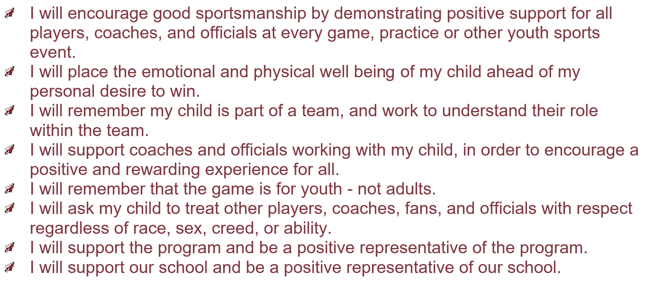
Game Day Operations
Ticketing Administration
Ticket Takers
Concession Operations
Concessions Staff
Field Setup
Stadium Announcer
Game Recording
Ball Kids
Event Planning
End of Year Banquet
Senior Recognition / Senior Night
Team Dinners
Other Game Day Events (Community Night, Teacher Appreciation, etc.)
Other:
Marketing and Finance
Sponsorships
Finances and Accounting
Other:
Program Administration
Uniforms
Team Apparel
Fan Apparel
florida state university schools
girls’ soccer program
Parent Expectations

Slide 30
Game Day Operations
Ticketing Administration
Ticket Takers
Concession Operations
Concessions Staff
Field Setup
Stadium Announcer
Game Recording
Ball Kids
Event Planning
End of Year Banquet
Senior Recognition / Senior Night
Team Dinners
Other Game Day Events (Community Night, Teacher Appreciation, etc.)
Other:
Marketing and Finance
Sponsorships
Finances and Accounting
Other:
Program Administration
Uniforms
Team Apparel
Fan Apparel
florida state university schools
girls’ soccer program
Sportsmanship
1. Know, understand and appreciate the rules of the contest.
2. Show respect for the Officials. Good sportsmanship implies a willingness to accept and abide by the decisions of the Officials.
3. Show respect for the opponent at all times. Good sportsmanship is the Golden Rule in action.
4. Recognize and appreciate skill in performance regardless of affiliation.
5. Maintain self-control at all times. Good sportsmanship is concerned with the behavior of all involved in the game.
6. Show a positive attitude in cheering. Refrain from intimidating or negative cheering. Good sportsmanship is cheering your own team "on to victory"

Slide 31
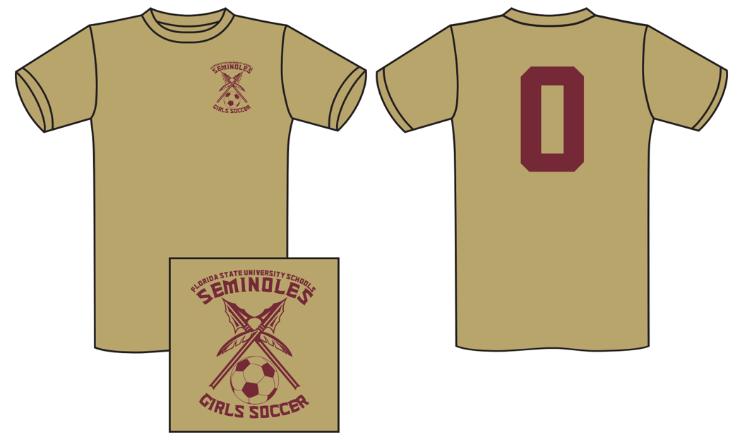
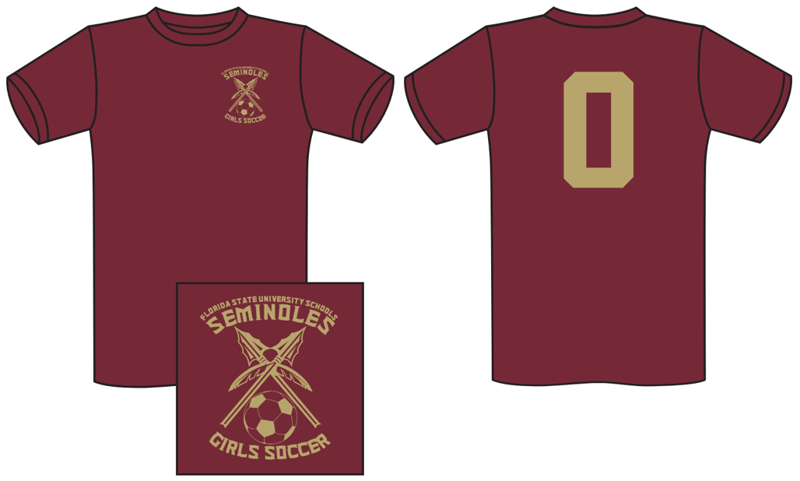
florida state university schools
girls’ soccer program
Tryout and Practice Jerseys

Slide 32
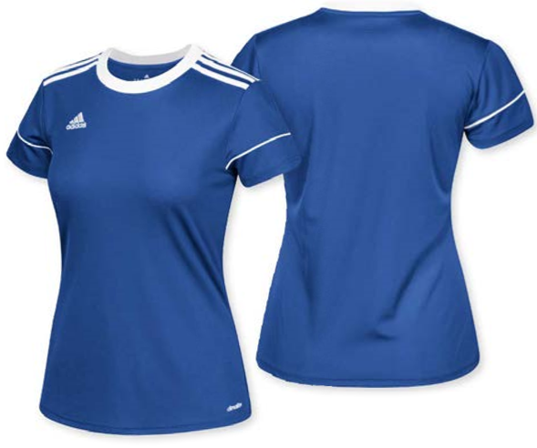
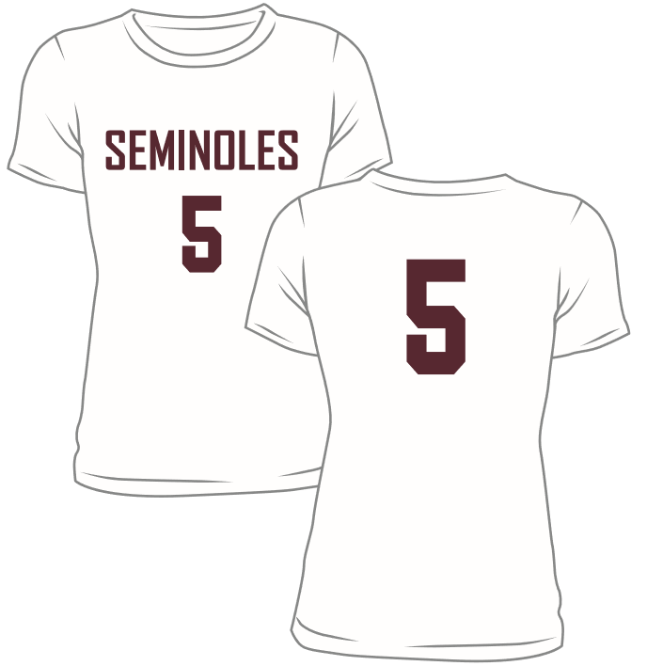
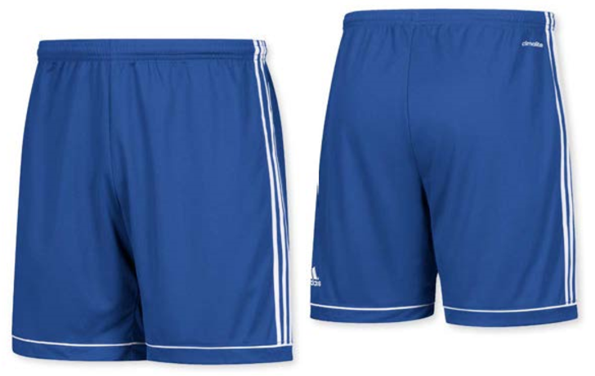
florida state university schools
girls’ soccer program
Away Jerseys

Slide 33
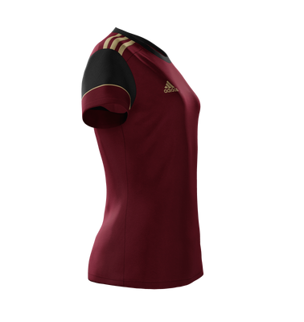

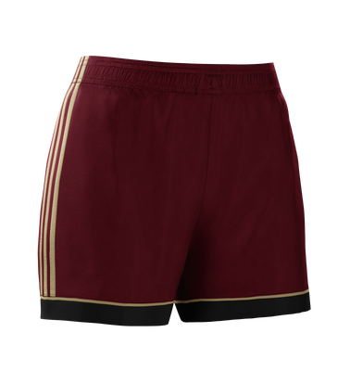
florida state university schools
girls’ soccer program
Home Jerseys

Slide 34
florida state university schools
girls’ soccer program
2018-2019

